Slide 1
NEUTRONS
Electrically neutral
Having mass almost identical to that of Hydrogen
Neutron energy range 0.025 eV to 50 MeV

Slide 2
Neutron
Slow less than 100 eV
Inter mediate- 100 eV to 100kev
Fast neutron- greater than 100keV
Epithermal 0.1 eV to 100 eV
Thermal 0.025 eV

Slide 3
NEUTRON LOG
Logging tool emits high energy neutrons into formation
Neutrons collide with nuclei of formation’s atoms
Neutrons lose energy (velocity) with each collision
Notes:
‹#›
‹#›

Slide 4
NEUTRON LOG
The most energy is lost when colliding with a hydrogen atom nucleus
Neutrons are slowed sufficiently to be captured by nuclei
Capturing nuclei become excited and emit gamma rays
Notes:
‹#›
‹#›

Slide 5
NEUTRON LOG
Depending on type of logging tool either gamma rays or non-captured neutrons are recorded
Log records porosity based on neutrons captured by formation
If hydrogen is in pore space, porosity is related to the ratio of neutrons emitted to those counted as captured
Neutron log reports porosity, calibrated assuming calcite matrix and fresh water in pores, if these assumptions are invalid we must correct the neutron porosity value
Notes:
‹#›
‹#›

Slide 6
Hydrogen is the most efficient in slowing down and reducing the energy of neutrons.
In formations containing 100 percent water saturation, neutrons are thermalized within 8 centimeters.
The same formations having 1 percent water saturation will thermalize neutrons within 18 to 26 centimeters.
The depth of investigation is dependent on porosity and as porosity decreases, the depth of investigation increases.
It has been estimated that 90 percent of the response in a dry sand will come from a depth of investigation of less than 58 cm.

Slide 7
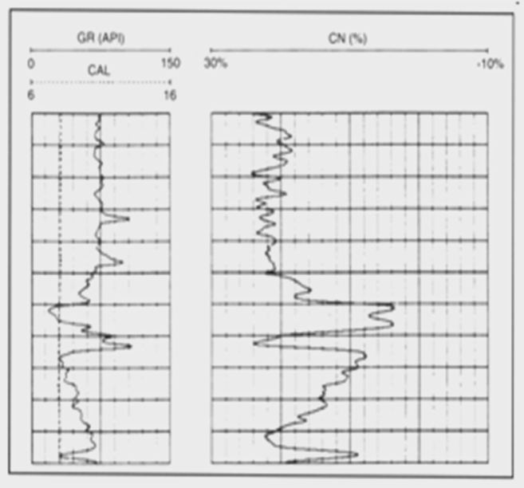

Slide 8
POROSITY FROM NEUTRON LOG
001) BONANZA 1
0
GRC
150
0.2
ILDC
200
1.95
RHOC
2.95
150
us/f
DT
50
-160
SPC
MV
40
0.2
SNC
200
0.45
CNLLC
-0.15
6
ACAL
16
0.2
MLLCF
200
CNLLC
10700
0.45
-0.15
10800
Neutron
Log
10900
Notes:
‹#›
‹#›
Uses a radioactive source to bombard the formation with neutrons
For a given formation, amount of hydrogen in the formation (I.e. hydrogen index) impacts the number of neutrons that reach the receiver
A large hydrogen index implies a large liquid-filled porosity (oil or water). The hydrogen index is calibrated to limestone porosity. If the lithology is sandstone or dolomite, the following chart can be used to correct the porosity.

Slide 9
NEUTRON SOURCE
Neutron source are intimate mixers of Beryllium (₄ Be ⁹ ) and alpha emitting radioactive elements such as Radium (₈₈ Ra ²²⁶ ).
As Radium spontaneously decay, it emits sizable quantizes Of alpha partials (₂ He ⁴ ) and gamma ray ( γ ).
The commercialized Beryllium responds to the alpha bombardment by radiating a stream of medium energy neutrons in accordance with the following reaction
₄ Be ⁹ + ₂ He ^{4 →} ₆ C 12 + ₀ n ¹

Slide 10
Plutonium 236- Beryllium (Pu Be)
5 curies activity, produces 8.5 million neutrons per second with average energy of about 4.5 Mev.
GR emission is reduced by a factor of two thousand from Ra Be source
Good stability due to long half life 24,360yrs.
The low specific activity of Plutonium requires this source to have a relatively large physical dimension.

Slide 11
Radium 226 – Beryllium (Ra Be)
300 milli curi activity- generates about 4.5 million electron volt (Mev) per second with energies from 1 to 13 Mev with average of 4.5 Mev.
Half life of radium (1620 yrs )
Production of undesired GR is disadvantage.
The source has to be heavily shielded to protect
GR and also interfere with desired measurements.

Slide 12
Americium 241-Beryllium (Am Be)
4 curie activity.
Neutron emission about ten million per second with 4.5 Mev average energy.
Low gamma emission,
Half life 458 yrs.
Gives good source stability.

Slide 13
ALPHA – NEUTRON SOURCES
This type of source is most commonly used. Alpha particle sources such as Pu, Po, Am, are combined with Be (beryllium).
As the alpha particles bombard the beryllium, neutrons are produced. The energies of these neutrons are between 1 MeV and 12 MeV.
he higher energy levels permit deeper penetration and greater depths of investigation.

Slide 14
FOUR DETECTOR TYPES ARE USED:
BF3 counters – This is a common detector similar to a Geiger-muller tube. The efficiency is fairly low.
He3 counters – This is a more modern detector similar to the BF3 detector but 4 to 20 times more efficient.
Epithermal neutron detectors – This is a cadmium shielded gas type detector.
Gamma ray detectors – This detector is used to detect gamma rays of capture rather than neutrons.

Slide 15
Neutron detector
3He counter
Neutron detector consists of glass tube filled with a gas which serves as target nucleus for neutron capture and produces alpha particles.
These alpha particles produces
Ionization in the gas, the ionization current used to detect the neutron population.

Slide 17
High energy neutrons 5Mev
Billiard ball reaction.

Slide 18
NEUTRON LOGGING
The Neutron Log is primarily used to evaluate formation porosity, but the fact that it is really just a hydrogen detector should always be kept in mind
It is used to detect gas in certain situations, exploiting the lower hydrogen density, or hydrogen index
The Neutron Log can be summarized as the continuous measurement of the induced radiation produced by the bombardment of that formation with a neutron source contained in the logging tool which sources emit fast neutrons that are eventually slowed by collisions with hydrogen atoms until they are captured (think of a billiard ball metaphor where the similar size of the particles is a factor).
The capture results in the emission of a secondary gamma ray; some tools, especially older ones, detect the capture gamma ray (neutron-gamma log).
Other tools detect intermediate (epithermal) neutrons or slow (thermal) neutrons (both referred to as neutron-neutron logs).
Modern neutron tools most commonly count thermal neutrons with an He-3 type detector.

Slide 19
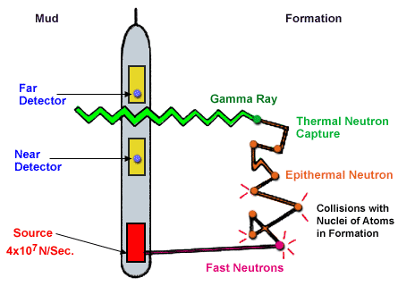
NEUTRON LOGGING

Slide 20
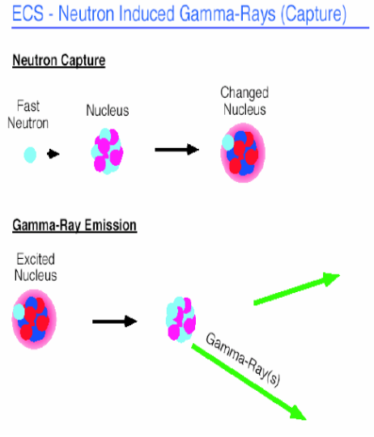

Slide 21
Neutron tool measures the Hydrogen concentration in the formation.

Slide 22
The slowing down of neutrons and the inverse of the number of neutrons which eventually manage to reach the detector depends mainly on the number of Hydrogen atoms present in the formation,
which is directly proportional to the Amount of water or Hydrogen contained in the formation,
Directly related to the porosity of the rock.

Slide 23
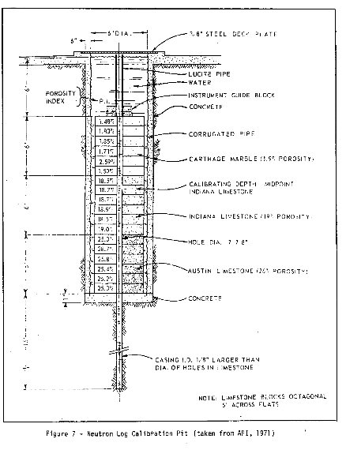

Slide 24
NEUTRON POROSITY IS CALCULATED BASED ON NEUTRON TOOL RESPONSE IN KNOWN LITHOLOGIES HAVING KNOWN POROSITY.
Tool response is specified in terms of American Petroleum Institute (API) units. The standard unit for neutron logging tools is the “API Neutron Unit”. 1000 API units is assigned to any neutron tool in a water filled hole having 7 - 7/8 inch diameter in Indiana Limestone of 19 percent porosity. One API Neutron Unit is 1/1000 of the difference between tool instrument zero and the log deflection in the Indiana Limestone section. The API test well is located at the University of Houston, Houston, Texas.
When a tool is calibrated at the API test well, its response to a standard neutron calibrator is also determined. The differential deflection produced by this two environment device is compared to the API test well deflection representing 1000 API Units. A definite number of API units can then be assigned to a tools calibrator deflection. This calibration figure must be determined for each model or series of tool.

Slide 25
Each tool supplier develops a transform from API units to porosity for the neutron tools they produce.
The general equation is:
Porosity (f) = natural log (API Log counts * constant + constant)
Neutron Porosity is based on a Limestone matrix (Indiana Limestone).
A correction to obtain porosity for a sandstone matrix is:
Porosity (fss) = 0.95 (f(n)) + .035

Slide 26
Shales: Although the effective porosity of shale is NIL.
The neutron will read high porosity because shale actually contains a lot of water, therefore lot of Hydrogen atoms.
Gas: The number Hydrogen atoms in gas is much lower than Oil or water.
As a result neutrons tool reads low in porosity.

Slide 27
Neutron measured porosity differs from effective porosity whenever shale or gas is present in the formation.
However accurate porosity can be determined by comparing with other tools.

Slide 28
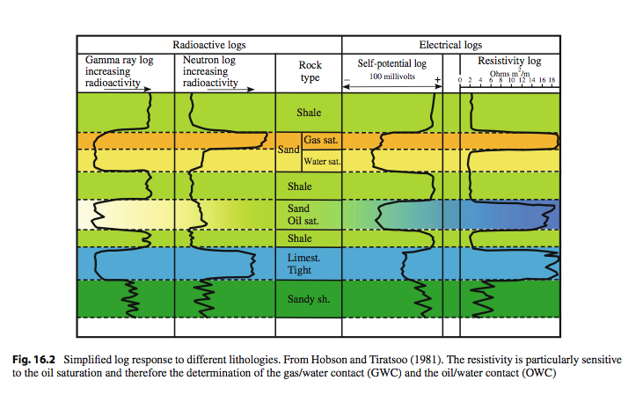
Note the use of “sand” in
petroleospeak for what most
of us would probably consider
a sandstone.
Note that a deflection to the left
(little radioactivity) only means
“not shale”, not permeability.
Bjørlykke 2010
Notes:
‹#›

Slide 29
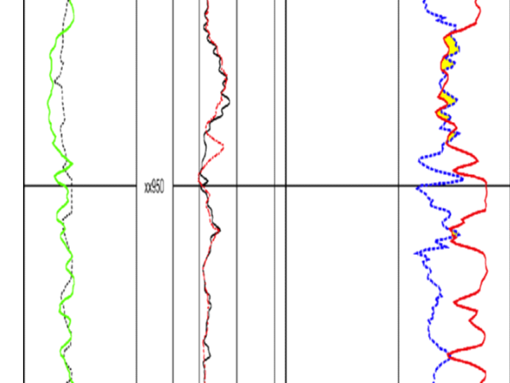

Slide 30
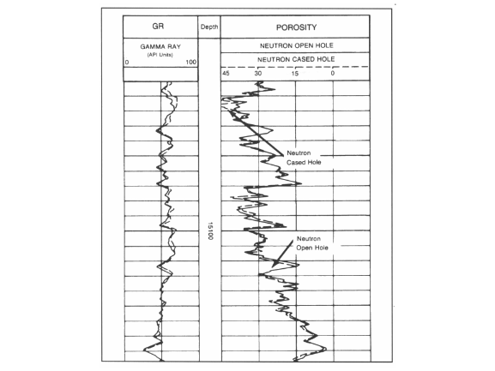

Slide 31
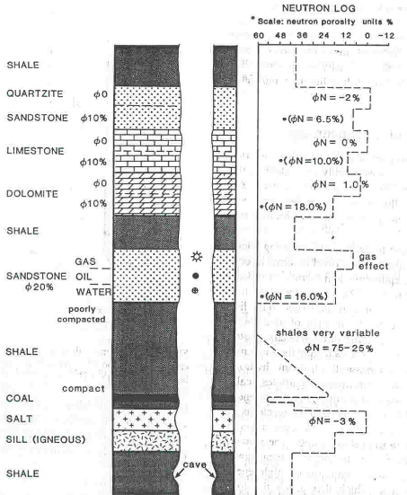

Slide 32
USES OF NEUTRON LOG
Porosity Analyses
Lithology identification
Clay analysis
Gas detection

