Slide 2
The study of the Engineering Properties of Rocks is termed Rock Mechanics, which is defined as follows:
“The theoretical and applied science of the mechanical behaviour of rock and rock masses in response to force fields of their physical environment.”
It is really a subdivision of “Geomechanics” which is concerned with the mechanical responses of all geological materials, including soils.

Slide 5
During Engineering planning, design and construction of works, there are many rock mechanics issues such as:
Evaluation of geological hazards;
Selection and preparation of rock materials;
Evaluation of cuttability and drillability of rock;
Analysis of rock deformations;
Analysis of rock stability;
Control of blasting procedures;
Design of support systems;
Hydraulic fracturing, and
Selection of types of structures.

Slide 6
The factors that influence the deformation and failure of rocks.
Such factors include:
Mineralogical composition and texture;
Planes of weakness;
Degree of mineral alteration;
Temperature and Pressure conditions of rock formation;
Pore water content, and
Length of time and rate of changing stress that a rock experiences.
Mineralogical Composition and Texture.
Very few rocks are homogeneous, continuous, isotropic (non directional) and elastic.
Generally, the smaller the grain size, the stronger the rock.

Slide 7
Texture influences the rock strength directly through the degree of interlocking of the component grains.
Rock defects such as microfractures, grain boundaries, mineral cleavages, twinning planes and planar discontinuities influence the ultimate rock strength and may act as “surfaces of weakness” where failure occurs.
When cleavage has high or low angles with the principal stress direction, the mode of failure is mainly influenced by the cleavage.
Anisotropy is common because of preferred orientations of minerals and directional stress history.

Slide 9
Strength and deformation properties play a very important role while designing structures in rocks.
Determining the appropriate strength parameters are important as the design should be in accordance with the type of structures, loading characteristics and characteristics of rocks in the bearing strata.
The important design aspects and the shearing failure possibilities are to be checked before any superstructure or heavy temporary load allowed on the bearing strata.
Appropriate tests to determine various strength properties for rock need to be planned before any final design.

Slide 10
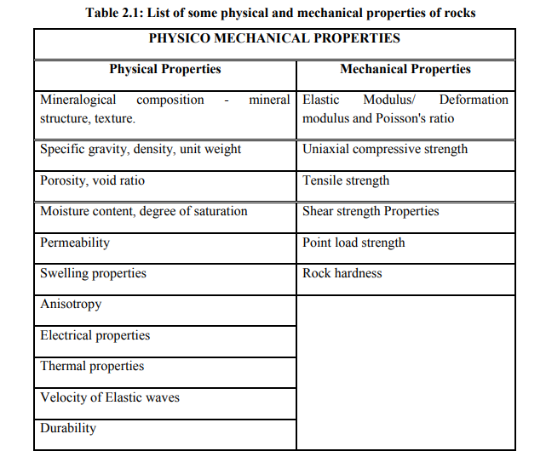

Slide 11
Strength characteristics:
Compressive strength: It is also referred as crushing strength of a stone and may be defined as the force expressed per unit area, which a stone can withstand without rupturing.
Any force applied beyond the Compressive strength will cause a failure or rupture of the stone.
Mathematically, uniaxial Compressive strength is expressed by a simple relationship:
Co = ρ/A
Where Co= Compressive strength/unit area; ρ= load at failure; A= Area of cross section of stone under ρ.
The Compressive strength of a rock depends on a no. of factors such as its mode of formation, its composition, texture and structure, its moisture content and extent of weathering.
Igneous rocks being crystalline character, very high compressive strengths compared to sedimentary and metamorphic rocks.

Slide 12
2. Transverse Strength: It is defined as the capacity of a stone to withstand bending loads. Such loads are only rarely involved in situations where stones are commonly used.
Transverse Strength is determined as modulus of rupture using the following relationship:
R= 3wl/2bd²
Where R= modulus of rupture; w= load at which sample breaks, l=length, b=width and d is thickness of the specimen.
It has been found that in stones, Transverse Strength is generally 1/10th to 1/20th of their compressive strength values.

Slide 13
3. Shear Strength : Shear strength is the resistance offered by a stone to shear stresses, which tends to move one part of a specimen with respect to the other.
It is obtained by using the relationship. Shear strength of a stone is also not commonly determined except when the stone is to be used as a column
Where P = load at failure; A = area of cross section of the specimen.
It has been observed that shear strength of most common building stones ranges from 70 to 140 kg/cm2.
Rupture occurs when the shear strength is exceeded.

Slide 14
4. Tensile Strength: Tensile strength of a rock is related to its ability to withstand breakage. It happens after some level. That level is its strength. It may be determined directly or indirectly.
The tensile (pulling) strength that has to be applied to a material to break it. It is measured as a force per unit area. The direct method would require elaborate means to avoid bending while applying tensile forces by gripping the specimens at the ends.
The indirect method is called the Brazilian test. It consists of loading a test cylinder diametrically in such a way that the applied loads would develop tensile rupturing along the diametrical plane of the specimen.
Loads are gradually increased till the cylinder fractures. The load P, at rupture being thus known. Transverse strength Ts is calculated by using the formula
D = diameter of the specimen; L = length of the specimen

Slide 15
5. Porosity: The size, shape and degree of packing of the component crystals or grains in a rock give rise to its porosity. Numerically it is expressed as the ratio between the total volume of the pore spaces and total volume of the rock sample and is expressed commonly in percentage terms.
Low porosity is caused by interlocking crystals, angular grains of different sizes and uniformly distributed cementing material in the rock.
6. The absorption value: It defines the capacity of a stone to absorb moisture when immersed in water for 72 hours or till it gets full saturation. It is generally expressed in percentage terms of original dry weight of the mass. . It maybe obtained from the relationship
:
Where Ws = weight at saturation; W0 = dry weight of the sample used.

Slide 16
7. Permeability: It is the capacity of a rock to transmit water. Sand stones and limestones may show high values for absorption or 10% or even more.
Selection of such highly porous verities of these stones for use in building construction, especially in most situations, would be greatly objectionable.
Presence of water within the pores not only decreases the strength of the rock but also makes the stones very vulnerable to frost action, in cold and humid climatic conditions.

Slide 17
8 Density : It is defined as weight per unit volume of a substance.
But in the case of rock it is not only the solid mineral matter which wholly accounts for the total volume of a given specimen.
A part of the rock may comprise of pores or open spaces, which may be empty, partly filled or wholly filled with water.
Accordingly, three types of density may be distinguished in rocks. They are a)Dry density, b) bulk density and c) saturated density.
1.Dry density: It is the weight per unit volume of an absolutely dried rock specimen, it includes the volume of the pore spaces present in the rock.
2.Bulk density: It is the weight per unit volume of a rock sample with natural moisture content where pores are only partially filled with water.
3.Saturated density: It is the density of the saturated rocks or weight per unit volume of a rock in which all the pores are completely filled with water.

Slide 18
The fourth type is also recognized as true density. Itis the weight per unit volume of the mineral matter(without pores and water) of which a rock s made up.
The most engineering calculations, it is the bulk density which is used frequently. Bulk density values in gram/cubic cm for some common building stones are granite-2.7, basalt-2.9, sandstone-2.6, and limestone-2.2 to 2.6.

Slide 19
9 Abrasive Resistance : It is more a qualitative than a quantitative property.
It may be broadly defined are the resistance which a stone offers to rubbing action of one kind or another.
Determination of this is of considerable significance when stones are intended for use in situations where rubbing by natural or artificial causes is involved as a routine.
Example a) stones used in paving along roads, b) Facing stones in buildings of arid region where strong sand laden winds are blown.
These type of situations demand stones that have not only high abrasive resistance but also of essentially uniform, composition.

Slide 20
10 Frost and fire resistance
Many building stones show quick disintegration of building stones or rocks when used in situations involving frost formation (excessive cold) or heating.
Frost causes disintegration by expansion of water on breezing within the rock pores.
In the case of fire, the unequal expansion in different mineral components and also at different depths from surface inwards may cause disintegration.
This effect becomes more pronounced when the rock is first heated and then suddenly cooled by water by water.
Heavy stones including granites crumble to pieces under such a treatment.
It is easy to understand that rocks which are found porous and weak in strength are easily deteriorated in cold humid climates by frost action.
Limestone and sandstones fall in this category. They show very poor frost resistance

Slide 21
Geological Characteristics:
Minerological composition: Rocks are made up of smaller units of the minerals.
Their properties depend upon the nature and composition of these minerals. It has been observed that rocks composed chiefly of silica (SiO2) especially in free form, are the strongest in all respects Quartzites are the strongest in all respects.
Fresh Quartzite, Sand Stone and granite are some of the examples.
Carbonate rocks show a wide variation in their properties. A particular deposit of these rocks has to be tested by taking random representative samples before the stone is recommended for use in engineering construction of any importance. Presence of some minerals even in small quantites is to be viewed with caution while using in building stones. These minerals are mica, gypsum, sulphides, tremolite, flint and chert and clays. These destroy the inherent strength of the rock.

Slide 22
2. Texture and Structure: Texture defines the size, shape and mutual relationship of the mineral compounds in a rock. Whereas structure determines the development of large scale features in the rock mass as a whole.
Rocks may be coarse grained, medium grained or fine grained.
The fine grained equigranular textured rocks are better building stones compared to coarse grained and inequigranular rocks.
Structurally speaking features like bedding planes, foliations, cleavage, joints and flow structures which might not be fully represented in small sized test specimens, but which may be present in rock masses on a large scale, have to be given due considerations

Slide 23
3 Resistance to weathering (Durability):
It is essentially a geological character of a stone that is commonly determined by its composition, texture and structure on the one hand and the climate environment where the stone is ultimately used on the other hand.
A stone may remain almost fresh and untarnished for 500 years or more when used in the interior of a building. But the same stone used on the exterior might get pitted and weathered badly within 100 years.
Good example is granite.
Similarly, limestone used in building construction, in industrial townships may weather badly and quickly due to reaction with sulphorous acid polluted air.
Whereas the same rock used only a little amount in temples and forts and historical buildings may last for centuries.

Slide 24
An engineer and especially a town planner has to bear in mind this fact that rocks also live and sensitive to the environment in which they are placed.
Durability of a stone can be experimentally determined by subjecting the stone sample to disintegrating action of Sodium sulphate.
Test specimens generally of 5cm side cubes, are dried perfectly and weighed.
They are suspended in 14% solution of Sodium sulphate for 4 hours at 27 degree Celsius and then air dried and oven dried at 105degree Celsius.
The stone samples are subjected to 30 such cycles and lots of weight determined which gives a measure of the durability of the rock.
Greater the loss in weight after these cycles, poorer is the durability of the stone.

Slide 25
General characters:
1Cost: It is an important consideration similar to engineering properties or geological character.
A stone may be quite suitable for use in building construction on first two considerations, but still it may not find use for the simple reason that it is uneconomical.
Cost of a building stone depends upon its availability, accessibility and workability.
Good quality building stones are not available elsewhere. Their transport from one place to another might be a very costly affair.
The workability of a stone is understood the ease in effort and economy with which it can be extracted from its place of occurrence and dressed to the desired dimensions and shapes. Harder and stronger rocks become costlier on these accounts

Slide 26
2 Color: Color is the property of appears and gets involved only where the stone is used in construction exposed to public view.
For stones to be used in foundations is dams or in situations where they are ultimately to be given covering, color of a rock has no relevance in its selection.
In the case of residential or official building, it becomes a property of major importance. The color of a rock is a geological character depending upon the type of rock and more precisely upon the composition of rock. Eg. Granites are light coloured, Basalt are dark, and Sandstone are lighter shades.

Slide 27
Modulus properties or Flexible strength or Elastic properties of rocks
The elasticity of rocks indicates their deformation under loads.
The deformation is recovered when loads are removed. It is determined in accordance with Hook’s law which states that in elastic substances stress is directly proportional to strain.
It is expressed by the relationship Q/E=E
Where Q= stress, E= Strain, E= Modulus of elasticity, It is also termed as young’s modulus

Slide 28
Mechanical properties
Stress and strain
When a stress σ (force per unit area) is applied to a material such as rock, the material experiences a change in dimension, volume, or shape. This change, or deformation, is called strain(ε). Stresses can be axial—e.g., directional tension or simple compression—or shear (tangential), or all-sided (e.g.,hydrostatic compression).
The terms stress and pressure are sometimes used interchangeably, but often stress refers to directional stress or shear stress and pressure (P) refers to hydrostatic compression.
For small stresses, the strain is elastic (recoverable when the stress is removed and linearly proportional to the applied stress). For larger stresses and other conditions, the strain can be inelastic, or permanent.

Slide 29
Elastic constants
In elastic deformation, there are various constants that relate the magnitude of the strain response to the applied stress. These elastic constants include the following:
(1) Young’s modulus (E) is the ratio of the applied stress to the fractional extension (or shortening) of the sample length parallel to the tension (or compression). The strain is the linear change in dimension divided by the original length.

Slide 30
(2) Shear modulus (μ) is the ratio of the applied stress to the distortion (rotation) of a plane originally perpendicular to the applied shear stress; it is also termed the modulus of rigidity.
(3) Bulk modulus (k) is the ratio of the confining pressure to the fractional reduction of volume in response to the applied hydrostatic pressure. The volume strain is the change in volume of the sample divided by the original volume. Bulk modulus is also termed the modulus of incompressibility.
(4) Poisson’s ratio (σ_{p}) is the ratio of lateral strain (perpendicular to an applied stress) to the longitudinal strain (parallel to applied stress).

Slide 31
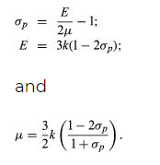
For elastic and isotropic materials, the elastic constants are interrelated. For example,
The following are the common units of stress:

Slide 32
PHYSICAL PROPERY
Density, unit weight, specific gravity and water content
Density of the rock is the mass of rock per unit volume where as unit weight of the rock is the weight per unit volume.
Highly porous rocks and relatively poor arrangement of grains (less packing) usually have relatively less densities and vice versa.
The bulk unit weight considers the bulk (total) volume of rocks where as the solid unit weight considers volume excluding the pores, fissures. Obviously, for porous rocks the unit weight of solid would be relatively higher than the bulk unit weight as the value in the denominator is relatively lower due to exclusion of pores and micro fractures.
Bulk unit weight depends on the type of rock, its
porosity and geological processes that take place in it.
Bulk unit weight of a rock may vary from region to region, some times in one location to another within the same geological formation.

Slide 33
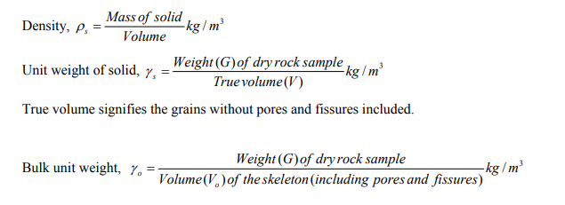
The water content of rock specimen can be calculated directly by dividing mass of pore water to mass of sample.

Slide 34
Porosity
Rocks contain voids in the form of pores, joints (fissures) etc. The voids may be inter connected or separated from one another. If they are inter connected and pressure gradient exists – rock can conduct fluids or gases. Porosity is an intrinsic property and is the ratio of the volume of openings (voids) to the total volume of material.
Porosity represents the storage capacity of the geologic material. The primary porosity of a sediment or rock consists of the spaces between the grains that make up that material. The more tightly packed the grains are, the lower the porosity.

Slide 35
Usually igneous or metamorphic rocks will have very low porosity (0-2%) where as sedimentary rocks like sandstones will have very high porosity (upto 40%).
Many factors which affect porosity like, grain size distribution, grain shape and arrangement, degree of cementation of grains, applied pressure etc.
Porosity decreases with increase of pressure and therefore, deep seated deposit with large overlying pressure may tend to have relatively low porosity compare to surface depositions

Slide 36
Rocks are commonly divided into three major classes according to the processes that resulted in their formation.
These classes are (1) igneous rocks, which have solidified from molten material called magma;
(2) sedimentary rocks, those consisting of fragments derived from pre existing rocks or of materials precipitated from solutions; and
(3) metamorphic rocks, which have been derived from either igneous or sedimentary rocks under conditions that caused changes in mineralogical composition, texture, and internal structure.

Slide 37
Thermal properties
Heat flow (or flux), q, in the Earth’s crust or in rock as a building material, is the product of the temperature gradient (change in temperature per unit distance) and the material’s thermal conductivity (k, the heat flow across a surface per unit area per unit time when a temperature difference exists in unit length perpendicular to the surface). Thus,

Slide 38
Rock mass properties: structural discontinuities
(a) Discontinuities related to plastic deformation
Apply standard geological mapping techniques to
determine strike and dip of folded structures (e.g.,
bedding) and strike and plunge of linear aspects (e.g.,
fold axes).
(1) Folded structures
A fold is a curve or bend of a planar structure such as
rock strata, bedding planes, foliation, or cleavage. It is
usually the product of plastic deformation.
(2) Foliation
Foliation is the planar arrangement of textural or
structural features

Slide 39
Discontinuities related to fracture deformation
A fracture (also called a crack, fissure, rupture, or
parting) is any mechanical break in a rock mass. Fractures occur in all rock types in virtually all structural domains (Davis 1984).
The characteristics of fractures strongly affect the engineering performance of rock.
Rock fractures can occur randomly or systematically
and with or without relative displacement across the
faces.
A joint is a planar or near-planar surface of
fracture or parting without visible displacement due to
mechanical failure induced by stress in a rock mass.
A fault is a fracture with visible relative displacement of
opposite faces due to mechanical failure induced by
stress.

Slide 40
Rock as a Construction Material
•For laying structural foundations to support structures
•For constructing Underground openings
•For protecting slopes
•For supporting railway tracks –Ballasts
•As base and sub-base for roads and runways
•As aggregate in concrete
•Making faciafor buildings.

Slide 42
Mechanical Properties of Rocks
▪ Rock properties: mass density, porosity, and permeability
▪ Stress
▪ Mohr's circle
▪ Strain
▪ Elasticity of rocks
▪ Rock properties: strength
▪ Engineering classification of intact rocks
▪ Rock mass properties

Slide 43
Rock properties:
▪ Specific gravity: the ratio between the mass and that of equal volume of water (i.e. the ratio of mass density and water density).
▪ Unit weight gamma=(specific gravity)x(unit weight of water)
unit weight of water= 62.4 pcf (lbs/ft3)
for most rocks, gamma = 120 to 200 pcf.
▪ Porosity n measures the relative amount of void space (containing liquids and or gases).
porosity=(void space)/(total volume)
▪ Permeability measures the rate at which fluids will flow through a saturated materials.

Slide 44
Stress
▪ Stress is force per unit area acting on a plane at any point within a material. There are three types of stresses:
▪ compressive stress: equal forces that act towards a point from opposite directions
▪ tensile stress: equal forces that pull away from each other.
▪ shear stress: equal forces that act in opposite directions but offset from each other to act as a couple.
Principal stresses
▪ On any plane within a solid, there are stresses acting normal to the plane (either compressional or tensional, called normal stresses) and shear stresses acting parallel to the plane. At any point within a solid, it is possible to find three mutually perpendicular principal stresses which are maximum, intermediate, and minimum. On the planes perpendicular to the principal stresses (called principal planes), there are not shear stresses.

Slide 45
Mohr's circle
▪ Suppose we wish to measure stresses (both normal and shear) acting on any given plane besides the principal stresses.
In general, this is a three dimensional problem and can be done using mathematical tensors and vectors.
▪ In a special case where we can assume that the intermediate and minimum stresses are equal (for example below the ground surface), we can work in two dimensions.
Mohr's circle provides a simple, graphical method to find the normal and shear stresses on inclined planes from principal planes using the maximum and minimum principal stresses.

Slide 46
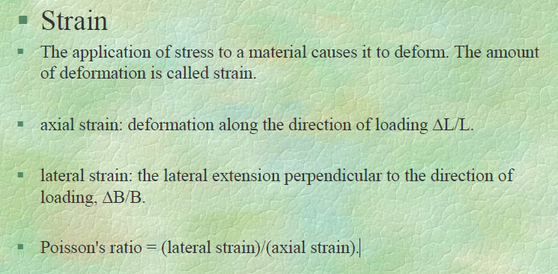

Slide 47
Elasticity of rocks
▪ Some of the deformation of a rock under stress will be recovered when the load is removed. The recoverable deformation is called elastic and the non recoverable part is called plastic deformation.
Plastic behaviour involves continuous deformation after some critical value of stress has been reached.
▪ Commonly, the elastic deformation of rock is directly proportional to the applied load.
The ratio of the stress and the strain is called modulus of elasticity.

Slide 48
Rock properties: strength
▪ Rock strength indicates the level of stress needed to cause failure.
▪ compressive strength is the compressive stress required to break a rock sample.
The unit is pounds per square inch (psi) or newtons per square meter (pascals).
▪ unconfined (uniaxial) compression test:
▪ the rock sample is unconfined at its side while the load is applied vertically until failure occurs. In this case, the compressive strength is called unconfined compressive strength
▪ confined compression test:
▪ For design of underground structure (such as tunnels, mining, waste repository), we need to take into account of the confining pressure at depth..

Slide 49
Engineering classification of intact rocks
▪ Intact rock is internally continuous, intact, and free from weakness planes such as jointing, bedding, and shearing.
▪ The standard engineering classification of intact rocks is based on the uniaxial compressive strength and the modulus of elasticity,
Rock classification also involves the modulus of elasticity. More specifically, the modulus ratio is used, which is the ratio of the modulus of elasticity to the unconfined compressive strength.
Three modulus ratio categories are H (high) for >500, M (medium) for 200-500, and L (low) for <200.

Slide 50
Classification of intact rocks
Igneous rocks:
Strong when consisting interlocking network of crystals (which explains the small range for granite).
For crystalline rocks, the smaller grain size gives higher strength (the average and maximum strength of basalt is higher than granite).
Extrusive rocks have variable strength, because of possible vesicular, pyroclastic textures.
Sedimentary rocks:
Limestone, dolomite: crystalline texture, thus generally strong, but variable (fossils).
Sandstone: wide range depending on the degree of cementation.
Shale: variable because of bedding.
Metamorphic rocks:
Strength increases in some cases because of compaction and recrystallization.
Schists have wide variation because of foliation.
Quartzite: strong because of interlocking silica crystals and absence of foliation.
Marble: similar to limestone or dolomite and smaller strength range

Slide 51
Rock mass properties
▪ The strength and deformation properties of intact rocks cannot be directly applied to the overall rock mass in the field situation.
The strength and behavior of a rock mass are largely controlled by the nature of its discontinuities or weakness planes.
Discontinuities act to lower the strength of the rock mass.
The rock mass tends to fail along existing weakness planes rather than develop new fracture within intact solid rocks.
▪ Examples of rock mass discontinuities include:
▪ sedimentary: bedding planes, sedimentary structure (mud cracks, ripple marks, cross beds, etc.)
▪ structural: faults, joints, fissures
▪ metamorphic: foliation
▪ igneous: cooling joints, flow contacts, intrusive contacts, dikes, sills

Slide 52
Temperature and Pressure
All rock types undergo a decrease in strength with increasing temperature, and an increase in strength with increasing confining pressure.
At high confining pressures, rocks are more difficult to fracture as incipient fractures are closed.
Pore Solutions
The presence of moisture in rocks adversely affects their engineering strength.
Reduction in strength with increasing H₂O content is due to lowering of the tensile strength, which is a function of the molecular cohesive strength of the material.
Time-dependent Behavior
Most strong rocks , like granite show little time-dependent strain or creep.

Slide 53
Since there are vast ranges in the properties of rocks, Engineers rely on a number of basic measurements to describe rocks quantitatively. These are known as Index Properties.
Index Properties of Rocks:
Porosity- Identifies the relative proportions of solids & voids;
Density- a mineralogical constituents parameter;
Sonic Velocity- evaluates the degree of fissuring;
Permeability- the relative interconnection of pores;
Durability- tendency for eventual breakdown of components or structures with degradation of rock quality, and
Strength- existing competency of the rock fabric binding components.

Slide 54
Deformation and Failure of Rocks:
Four stages of deformation recognized:
Elastic;
Elastico-viscous;
Plastic, and
Rupture.
All are dependent on the elasticity, viscosity and rigidity of the rock, as well as temperature, time, pore water, anisotropy and stress history.
Elastic deformation disappears when responsible stress ceases.
Strain is a linear function of stress thus obeying Hooke’s law, and the constant relationship between them is referred to as Young’s modulus (E).
Rocks are non ideal solids and exhibit hysteresis during unloading

Slide 57
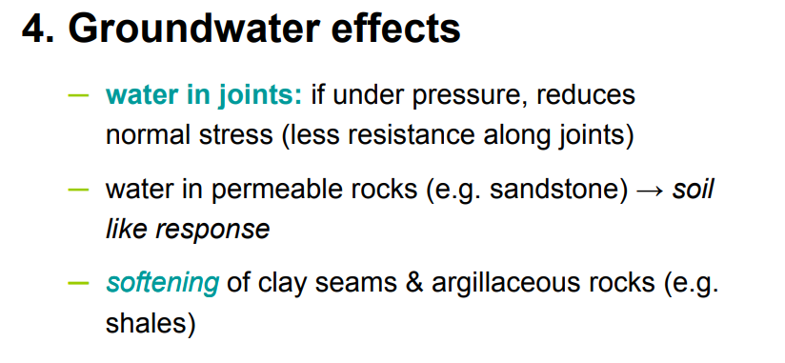
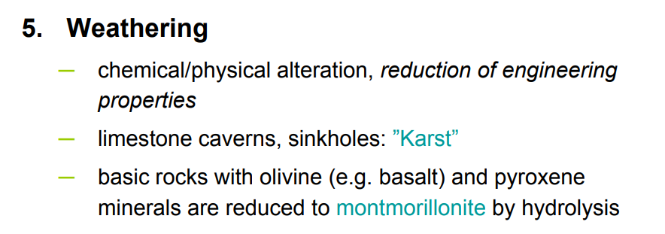

Slide 59
