Slide 1
When strata are exposed on an uneven land surface, the trend of the outcropping edge of a horizontal bed bends round the spurs and up the valleys

Slide 2
(Effects of topography on the outcropping edges Vertical strata
Outcrops of vertical strata with uniform strike trend straight across hills and valleys with no relation to topography

Slide 3
Rule of Vs
The relation between the disposition (attitude) of beds, their outcrop pattern and topography can be remembered by the “rule of V-s”
(i) Outcrop of a horizontal bed forms a ‘V’ with apex pointing upstream, as it crosses a valley;

Slide 4
(ii) outcrop pattern of beds that are inclined (dip) upstream forms a ‘V’ that points upstream

Slide 5
(iii) outcrop pattern of beds that dip downstream at an angle greater than the stream gradient forms a ‘V’ with apex pointing downstream

Slide 6
(iv) outcrop pattern of beds that dip downstream at angle less than the stream gradient forms a ‘V’ that points upstream.

Slide 7
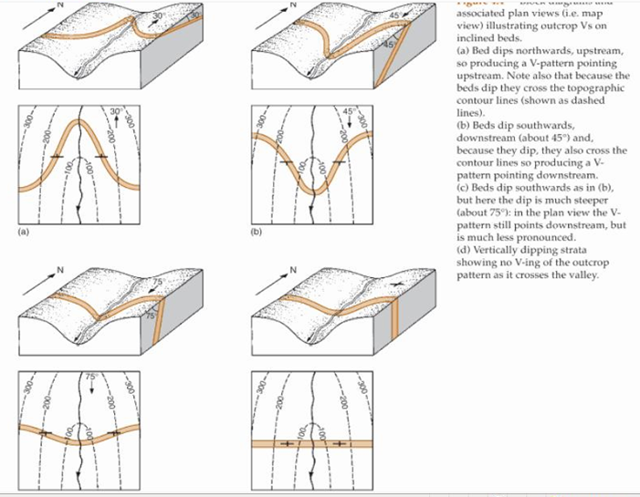
Outcrop Vs of inclined beds

