Slide 1
Stratigraphic Concepts and Nomenclature
Rabindranath Sar
Faculty
GSI Training Institute

Slide 2
What is Stratigraphy ?
The branch of geology which deals with sequential arrangement of layered rocks according to the time of their formation on the surface of earth.
It is primarily used in the study of Sedimentary and layered volcanic rocks.
The theoretical basis for the subject was established by Nicholas Steno who re-introduced the Law of Superposition and introduced the Principle of original horizontality and Principle of lateral horizontality in a 1669 work on the fossilization of organic remains in layers of sediment.
Smith, known as the Father of English Geology, created the first Geological Map of England, and first recognized the significance of Strata or rock layering, and the importance of fossil markers for correlating strata.

Slide 3
Terminologies
Stratigraphic principles: The laws that govern sequential organization /arrangements strata, rock bodies, sediments, soil etc.
Stratigraphic code: Seeks to describe practices for classifying and naming
all formally defined geologic units
Stratigraphic guide: deals with principles and procedures that have been adopted by various committees and commissions on stratigraphy.

Slide 4
Succession:
i. Stratigraphic: a number of rock units orderly stacked to succeed
one another in chronologic order
ii. Biotic: Progressive change in a biologic community as a result of response of member species to environment.
.

Slide 5
Sequence:
i. A succession of geologic events, process, rocks arranged in chronologic order
ii. Stratigraphic sequence: Chronologic succession of sedimentary
rocks from older to younger, essentially without interruption and bounded by
unconformities.

Slide 6
Facies: implies total aspect of a rock body; the term should be used for specific category as stratigraphic facies, lithofacies, biofacies, igneous facies, metamorphic facies etc

Slide 7
Correlation (equivalency or correspondence )
Principles of correlation:
demonstration of equivalency or correspondence among detached rock bodies are based on lithologic, biologic and intrinsic properties and absolute time.
correlation is restricted to units of a particular category.
Three kinds of correlation
Lithocorrelation links units of similar lithology and stratigraphic position
Biocorrelation expresses similarity of fossil content and biostratigraphic position
Chronocorrelation expresses correspondence in age and chronostratigraphic position.

Slide 8
Homotaxy:
Similarity in separate regions of the serial arrangements of succession of strata of comparable positions or of included fossils.
Similarity in succession does not prove age equivalence of the comparable units.

Slide 9
Region 1
Region 2
C
B
A
C₁
B₁
A₁
Chronotaxy: Similar stratigraphic sequences composed of units that are of
equivalent age.
Procedures of correlation includes paleontologic, lithologic, statistical,
isotopic and paleomagnetic
U₂
t₃
C
B
A
F
E
D
t₂
t₁
U₁

Slide 10
Stratigraphic principles
There are few basic “Principles, or Laws”, in geology used to study field geology and to understand geological history/stratigraphy of the area, country or continent.
These laws govern or guide to know the relative timing of events.
Relative and Absolute Dating
Geological events can be given a precise date at a point in time, or they can be related to other events that came before and after them. Geologists use a variety of methods to give both relative and absolute dates to geological events. They then use these dates to find the rates at which processes occur.

Slide 11
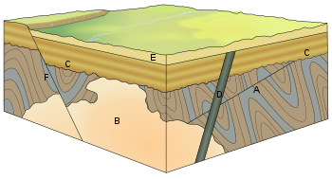
Relative dating

Slide 12
Principle of cross-cutting relationships
Principle of intrusive relationships
Principle of inclusions and components
Principle of uniformitarianism
Principle of original horizontality
The principle of superposition
Principle of faunal succession

Slide 13
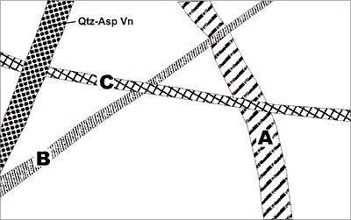
C
B
A

Slide 14
Principle of Uniformitarianism
The “Principle of Uniformitarianism” states that the earth is a result of natural forces which are presently active and have persisted over the course of geologic time.
Rocks form most often as a result of slow, gradual developments resulting from various geologic processes.
Catastrophic events do occur and contribute to the overall development and history of rocks, but these events are less frequent and contribute to only a small percentage of the net effect of natural forces in general.
This principle has been used to study the history of ancient volcanic rocks by observing present day volcanic activity

Slide 15
The principle of original horizontality states that the deposition of sediments occurs as essentially horizontal beds. Observation of modern marine and non-marine sediments in a wide variety of environments supports this generalization (although cross-bedding is inclined, the overall orientation of cross-bedded units is horizontal).

Slide 16
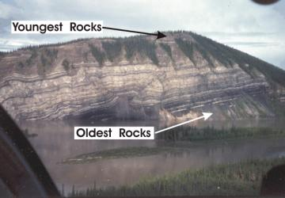
The principle of superposition states that a sedimentary rock layer in a tectonically undisturbed sequence is younger than the one beneath it and older than the one above it. Logically a younger layer cannot slip beneath a layer previously deposited. This principle allows sedimentary layers to be viewed as a form of vertical time line, a partial or complete record of the time elapsed from deposition of the lowest layer to deposition of the highest bed.

Slide 17
The principle of faunal succession is based on the appearance of fossils in sedimentary rocks.
As organisms exist at the same time period throughout the world, their presence or (sometimes) absence may be used to provide a relative age of the formations in which they are found.
The principle becomes quite complex, however, given the uncertainties of fossilization, the localization of fossil types due to lateral changes in habitat (facies change in sedimentary strata), and that not all fossils may be found globally at the same time.

Slide 18
The principle of inclusions and components states that, with sedimentary rocks, if inclusions (or clasts) are found in a formation, then the inclusions must be older than the formation that contains them. For example, in sedimentary rocks, it is common for gravel from an older formation to be ripped up and included in a newer layer. A similar situation with igneous rocks occurs when xenoliths are found. These foreign bodies are picked up as magma or lava flows, and are incorporated, later to cool in the matrix. As a result, xenoliths are older than the rock which contains them.

Slide 19
Absolute dating
Geologists can also give precise absolute dates to geologic events. These dates are useful on their own, and can also be used in conjunction with relative dating methods or to calibrate relative dating methods.
A large advance in geology in the advent of the 20th century was the ability to give precise absolute dates to geologic events through radioactive isotopes and other methods.
The advent of radiometric dating changed the understanding of geologic time. Before, geologists could only use fossils to date sections of rock relative to one another.
With isotopic dates, absolute dating became possible, and these absolute dates could be applied fossil sequences in which there was datable material, converting the old relative ages into new absolute ages.

Slide 20
Formal and Informal names and Units
Any Stratigraphic Unit which is derived and named as per the standard code of nomenclature in a Formal Unit.
Earlier established stratigraphic units and names are known as Informal Units.

Slide 21
Stratigraphic Correlation:
Correlation of rock formations of stratigraphic columns by matching their lithology, fossil content and order of superposition is known Stratigraphic Correlation.
Basis of correlation- Time
Lithology
Stage
Formations deposited at the same stage of the earth’s evolutionary history are referred as Homotaxial.
Crieria of correlation:
Palaeontological b) Non-palaeontological
As per order of superposition
Rocks deposited later will overlie the ones deposited earlier.
So older the rock, lower is the position in the stratigraphy.
The lower formations will contain fossils of primitive or less evolved forms.
Younger formations will contain evolved forms of life (fossil)

Slide 22
Non-palaeontological criteria
For unfossiliferous Rocks (Precambrians) criteria adopted are
Order of superposition
Principle of cross cutting relationship
Use of top and bottom identification criteria by study of sedimentary structures.
Petrological studies-texture, min.comp. and microstructures.
Use of marker bed/horizon
Heavy mineral concentration.
Deformations
Grade of metamorphism (not always true)
Age dating

Slide 23
Marker Horizon:
A rock unit with distinct lithology.
Rock formations situated in between two marker horizons in neighboring area are considered as of same age.
There should not be any evidence of erosion between two marker horizons if they are correlatable.
Unconformity:
Older rocks undergoing deformation get partly eroded.Thus an erosion plane develops overtime and no deposition has taken place during that period.
The plane which thus formed represents a stage of erosion and non-deposition. Such a plane is an Uncorfprmity.
An unconformity is a buried erosion surface separating two rock masses or strata of different ages, indicating that sediment deposition was not continuous
Unconformities are greatly used in stratigraphic classification and correlation.
Formations lying between two successive unconformities are considered of same age.

Slide 24
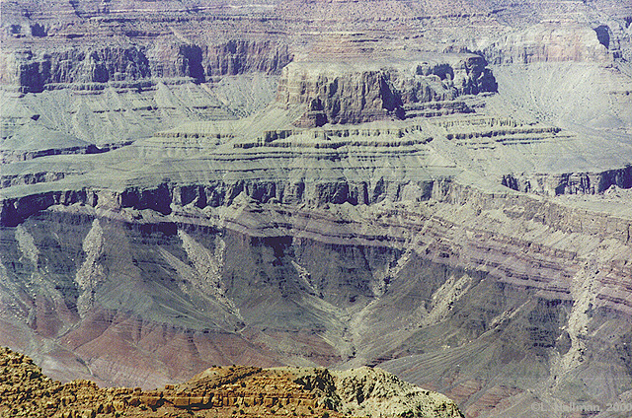
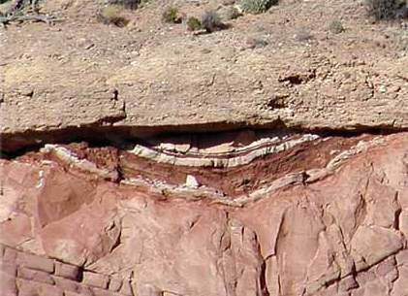
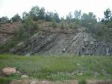

Slide 25
Other criterias:
Geophysical Methods-
Electrical logging
Gamma Ray logging
Seismic Stratigraphy-
Mostly P-wave reflections used
Seismic data along with logging data including geological core logs used in arriving stratigraphic correlation.
Palaeomagnetism-
Magnetostratigraphy
Radiometric dating-
Ratio of parent element and daughter element amount is used to calculate the time of formation of a mineral constituent of the rock containing the radio element. This is calculated based on half life periods of decay .

Slide 26
Palaeontological Criteria:
Very reliable criteria
Floral and faunal assemblags never repeat in geological time scale and life forms get evolved over time.
Thus fossil records are used thoroughly to know relative age of rocks.
Index Fossils:
Those forms of life which were extincted in a definite geologic age and got buried or fossilised in restricted litho horizons with wide geographic area are the index fossils.
Ex.Syringothyris limestone
Fossil Assemblege-
Group of fossils characterising rock units of different geologic time is a better tool in finding relative age of rocks than index fossil.
Micropalaeontology-Foraminifera, Ostracods, spores and pollens are used in stratigraphic correlation purpose.

Slide 27
Geological Time
Successive arrangement of stratigraphic and time units are standard reference for world wide correlation of geological units.
This is known as Standard Stratigraphic Scale or Geological Time Scale.
The scale is based on natural stage of evolution in the earth’s history.
Rock sequences and its fossil content are the records of geological time scale.
Palaeontology has been the most important tool for classifying or defining major divisions of the geological time scale.
Thus geological time scale is a reflection of Chronostratigraphic units.

Slide 28
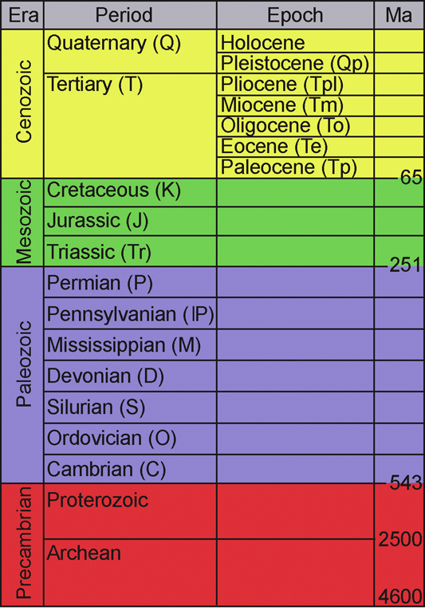

Slide 29
Stratigraphic Classification:
The grouping or classifying of strata related to sedimentary and volcanic rock formations based on their lithological characters and fossil contents
is called Stratigraphic Classification.
With classification of rock successions Stratigraphic Units are defined.
There are three principal types of Stratigraphic Units as per code of stratigraphic nomenclature
Litho-Stratigraphic Units
Biostratigraphic Units and
Chronostratigraphic Units

Slide 30
Lithostratigraphic Classification:
There are limitations in Chronostratigraphic classification-
It was first used for Europe
When other areas in Asia, Africa and America were mapped, standard stratigraphic divisions cannot be applied everywhere because of different evolutionary history of different segments of the earth.
Within the same country while Erathem and Systems could be used, it was difficult to correlate at Series and Stage level.
Unfossiliferous formations cannot be classified in this syste.
A new scheme was developed, known as Lithostratigraphic Classification.
Lithostratigraphic Classification is
based on lithological criteria
regional naming
following basic principles of stratigraphy and correlation.

Slide 31
Lithostratigraphic units
A lithostratigraphic unit is a defined body of sedimentary, extrusive igneous rocks,meta-sedimentary or meta-volcanic strata distinguished and delimited
on the basis of lithologic characteristics and stratigraphic position.
LU is commonly Stratified and tabular, and generally conforms to Law of Superposition.
Boundaries are placed at positions of lithic change with distinct contact or arbitrarily within the zone of gradation. In case of lateral gradation or intertongues, a new named unit may be proposed for the zone of gradation or intertongues.
Low grade metamorphic rock, volcanic rock, interbedded volcanic and sedimentary rock, organic reef and carbonate mounds are formal litho-stratigraphic units, depending on mappability..

Slide 32
Ranks of Lithostratigraphic Units
Supergroup
Group
Subgroup(rare use)
Formation
Member
Bed/Beds(rare use)

Slide 33
Definitions of Lithostratigraphic Ranks:
Bed-is the lowest rank in formal stratigraphic classification.
Example- a coal seam
Member- A package of beds which form a formal unit in a formation characterised by distinct lithology or fossil content. Ex.Prang Member of Sylhet Limestone.
Formation-is the fundamental unit of lithostratigraphic classification..
It is a mappable unit in 1:50K scale
1.It is represented by a rock succession deposited under a relatively uniform physicochemical conditions.
2.It may comprise a single litho unit or a closely related association of rock types.
3.Boundaries fixed based on change of lithology, may be even gradational.
4.It can be purely sedimentary rocks, layered igneous rocks or sedimentary and penecontemporaneous igneous flows together.
Nomenclature- Koilikuntla Formation; Nandyal Shale

Slide 34
Group:
It is a broader unit in lithostratigraphic classification.
A thick succession of rock formations spread over a large area.(Basin/sub-basin)
Boundaries marked by unconformities.
It comprises more than one formation.
Nomenclature- Named after a Geographic place where it is well developed (type area) Example- Nallamalai Group
Supergroup:
An association of mutually related groups.
Example Cuddapah Supergroup.
Supergroup corresponds to Erathem
Group corresponds to System.
Complex- An association of a group of rock formations/units.
It is not a formal unit. It may include several groups, several formations, both igneous and metamorphic rock units.Example-PGC, BGC

Slide 35
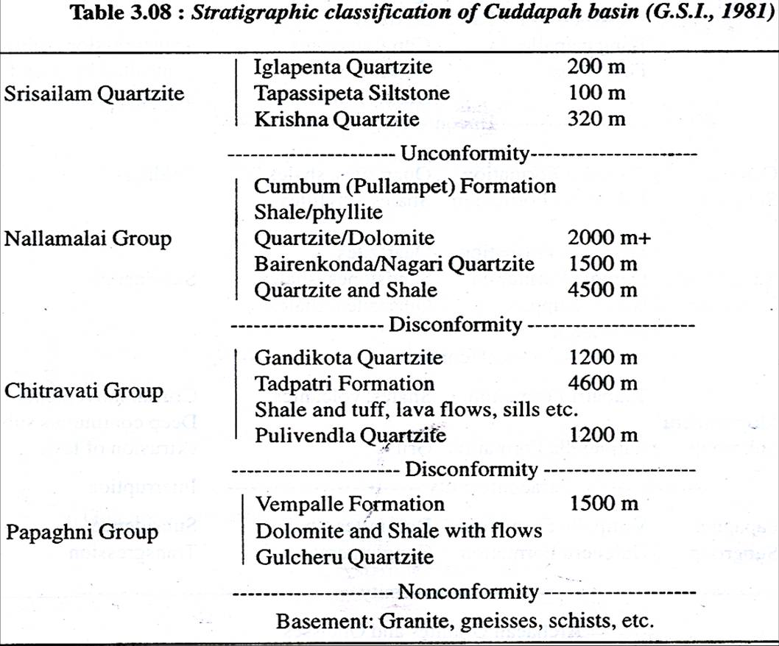
C
u
d
d
a
p
a
h
S
u
p
e
r
g
r
o
u
p

Slide 36
Biostratigraphic unit
A biostratigraphic unit is a body of rock that is defined by its fossil content.
Uniqueness lies because their fossil contents record unidirectional
Organic evolution.
Fossils are contemporaneous with the body of rock that contain them.
Biostratigraphic unit is independent from lithostratigraphic unit and chronostratigraphic unit. Boundaries between them, may or may not coincide.
As lithostratigraphic unit represents a depositional environment, it may be reflected with specific fossils so as to have positive relationship with chronostratigraphic unit.

Slide 37
Zone- Zone is the basic unit in biostratigraphic classification.
It is based on its fossils, may be of one phyllum, one class or one species.
Two types of formal zones-
Assemblage Zone (cenozone) and Range Zone (acrozone)
Ex. Oteceras-Ophiceras Assemblage Zone of Spiti (Triassic).
Assemblage zone should have a type section.
Assemblage/Range Zone is named after the fossil taxon.
Zonule- The smallest recognizable unit in an Assemblage Zone is a zonule.
Range Zone- It comprises the rocks in reasonable continuity that contains the taxon whose name it bears.
Ex.Numulites Range Zone in Assam
An Epibole-
It is the body of strata representing maximum development of a species or genus/peak of development.
Ex. Glossopteris epibole.It is noticed in Raniganj formation.

Slide 38
Nomenclature of Biostratigraphic Units
Initial letter of the zone or zonule has to be capital letter.
Species name after genus name has to be small letter.
Ex. Syringothyris cuspidata Assembly Zone.
Naming is based on international biological nomenclature.

Slide 39
Chronostraigraphic Units and Geological Time Units:
Each Chronostraigraphic unit represents a certain course in the Earth’s history. The rock sequences deposited during a certain duration of geologic time containing characteristic fossils constitute Chronostratigraphic Unit.
Geologic Time Units are on the other hand Abstract Units and are defined after the chronostratigraphic Unit.
A Chronostraigraphic unit is defined or designated as per a refrence section, known as Type Section.In the type section it should be able to coincide with a lithostratigraphic or biostratigraphic units.
What is the purpose of Chronostratigraphic Units?
Employed for correlation purposes.
Placing the rock in the systematic geological time sequence so as to indicate the age.

Slide 40
Its magnitude is measured in terms of length of trime interval and not by thickness.
Boundaries in a Type area defined by
1.Palaeontological criteria
2.Physical Criteria
3. Isotopic Age
4.

Slide 41
Ranks of Chronostraigraphic unit and Geologic-time Unit
Erathem Era
System -------------------------------------------Period
Series----------------------------------------------Epoch
Stage ----------------------------------------- Age
Substage

Slide 42
Earathem- An Erathem represents a succession of rock formations deposited during an Era.
It is the record of the broadest division in the earth’s history.
Its boundary is fixed as per major discontinuities in earth’s history.
Archaeologist, Proterozoic,Palaeozoic, Mesozoic, and Cainozoic are the five broad Earathems.
Its corresponding time unit is Era-
Archaeozoic Era, Proterozoic Era
Archaeozoic and Proterozoic are combinedly referred as Precambrian Eon.

Slide 43
System
It is lower in rank to Erathem.
It is the division of Erathem, defined by a succession of rocks which were deposited in a Period
In Phanerozoic rocks, fossil record is straight. So Systems are characterised by fossils.
Ex. Palaeozoic Erathem has 6 systems-
Cambrian, Ordovician, Silurian. Devonian, Carboniferous, Permian.
Mesozoic has 3 Systems- Triassic, Jurassic and Cretaceous;
Cainozoic has two- Tertiary and Quaternary
(2nd International Geological Congress-1881)
Names of systems derived from type areas.

Slide 44
Series
A Series is part of a System representing rock formations deposited during an Epoch.
In Phanerozoics, Series is characterised by typical fossil assemblages.
Series is assigned a name as per its position in the system like
Upper Damudas
Lower Damudas
Lower, Middle and Upper Gondwana.
Early. Middle and Late
In case of Tertiary special names are assigned to Series like
Palaeocene, Eocene, Oligocene, Miocene, Pliocene
Each Series is made of two or more Stages.
Damuda System

Slide 45
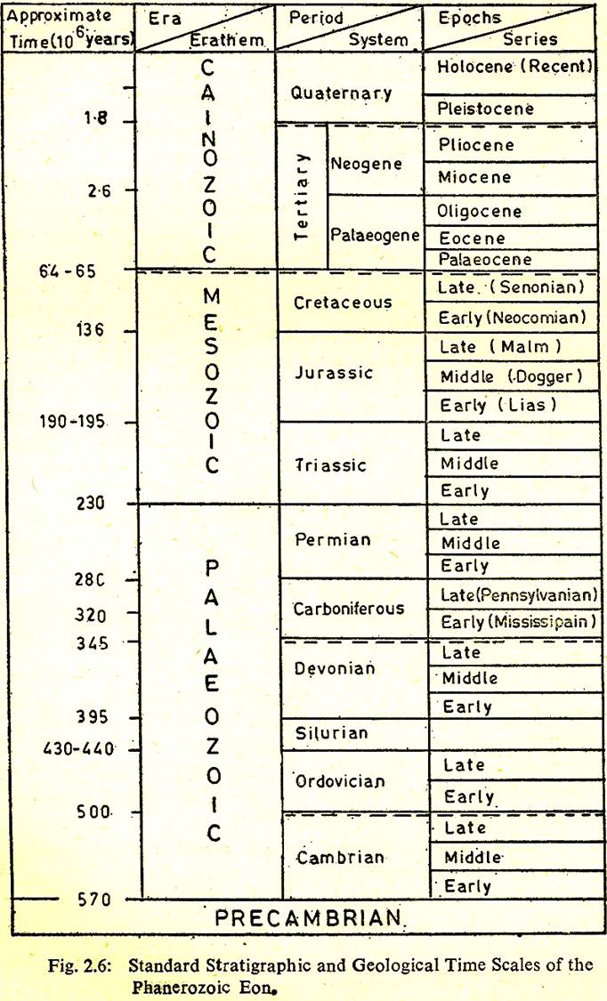

Slide 46
Stage is lower in rank to Series.
It represents rock successions deposited during a geologic age.
In Phanerozoics, a typical fossil assemblage having wide geographic distribution decides the stage.
Example- Oxfordian Stage of the Upper Jurassic belonging to Marl Series.
Zone is the smallest stratigraphic unit in Chronostratigraphic nomenclature.
It is defined by one most characteristic fossil from an assemblage.
Example-Globorotalia flexuosa Zone.

Slide 47
Magnetostratigraphic units
A magnetostratigraphic unit is a body of rock unified by specified
remanent-magnetic properties and is distinct from underlying and overlying units
having different magnetic properties.
Standard Stratigraphic Code considers only polarity reversals as a stratigraphic tool.
A magnetopolarity unit Is a body of rock unified by its remnant magnetic polarity. Boundary be placed at polarity reversal horizon.
Stratotype should be designated and boundaries defined in terms of recognized
Litho- or biostratigraphic unit in the stratotype.
A magnetopolarity zone is the fundamental unit and may contain rocks of entirely or predominantly one polarity, or mixed polarity. Its name is compound consisting a geographic name and the tern Polarity Zone. The term may include Normal, Reverse or Mixed. E. g. Deer Park Reversed Polarity Zone.

Slide 48
Formal Chronostratigraphic Units follow the following rules-
Naming is Binomial
Same name has to be given to the corresponding geologic time unit with the proper rank term.
The initial letters of both the terms should be capital letters.
Standard names accepted by the International Subcommission on Stratigraphic classification are followed.
There are other classifications
Geological -Climate Unit
Magnetostraigraphy(informal)
Chemical Stratigraphy(Informal)

Slide 49
Summary Stratigraphic code of nomenclature
The naming of Stratigraphic and geologic-time units according to established practices and principles is stratigraphic nomenclature .
Formal naming of a stratigraphic unit occurs when the unit is first proposed and described from a type section (STRATOTYPE), which acts thereafter as the standard reference for that unit.
Ideally, the name given is binomial
In the case of Chronostratigraphic and Lithostratigraphic Units, it consists of a preceding geographic name taken from the type locality (plus lithological description where appropriate), followed by the name of the unit, e.g. Pakhal Series; Muth Quartzite
The names of Biostratigraphic units consist of the name of the characteristic fossil plus the relevant unit term, e.g. Monograptus uniformis Range zone.
The name chosen for a stratigraphic unit should be unique to that unit.

Slide 50
When used as a proper name, the initial letters are capitalized.
Except in very special circumstances the first formal name given has priority and is adhered to.
In practice many well-known units, e.g. Barren Measures, were named long before the present conventions were established, and to avoid confusion these names are preserved in their original form.
Geologic-time units generally take their preceding name from that of the corresponding chronostratigraphic unit, plus the name of the unit (period, epoch,age, etc.),
Ex. the Jurassic Period, from the Jurassic System (named after the type area in the Jura Mountains).
The names of eons and eras (e.g. Precambrian Eon, Mesozoic Era) were proposed independently, so that the names for the corresponding eonothems and erathems are derived from the time units

Slide 51
Informal:
The informal naming of a Stratigraphic Unit occurs when
(a) the unit-term is referred to as an ordinary noun, and not in the context of a proper name, e.g. ‘the geologic periods’; and
(b) when a unit-term (such as zone or formation) is referred to without having been specifically established in classification,
e.g. ‘a sandstone formation’,
‘a mineralized zone’.
Terms used informally are not capitalized , may not be binomial

Slide 52
Correct use of words Incorrect
Supergroup Super group/ Super Group/Super-Group
Group group
Formation formation
(Bairenkonda Formation) (Bairenkonda formation)
Subgroup Sub Group
Tura Sandstone Turas Sandstone(Plural incorrect)
Kurnool Group Sandstones Group
Syringothyris cuspidata Assemblage Zone.
Or Syringothyris Cuspidata Assemblage Zone
Syringothyris cuspidata Assemblage Zone
Permian
Triassic Permo-Triassic
Duplicate use of geographic term for different ranks not allowed.

Slide 53
Stratigraphic Column:
An account of the sequence of deposition of layered rocks in any area is shown in a columnar form, known as Stratigraphic Column.
It is prepared on the basis of geological mapping, order of superposition taking account of structural and fossil data.
Based on comparison of Stratigraphic column of adjacent areas/ different areas can be correlated.
Similarly by correlating stratigraphic columns of neighboring regions, geologic history of continents is made.

Slide 54
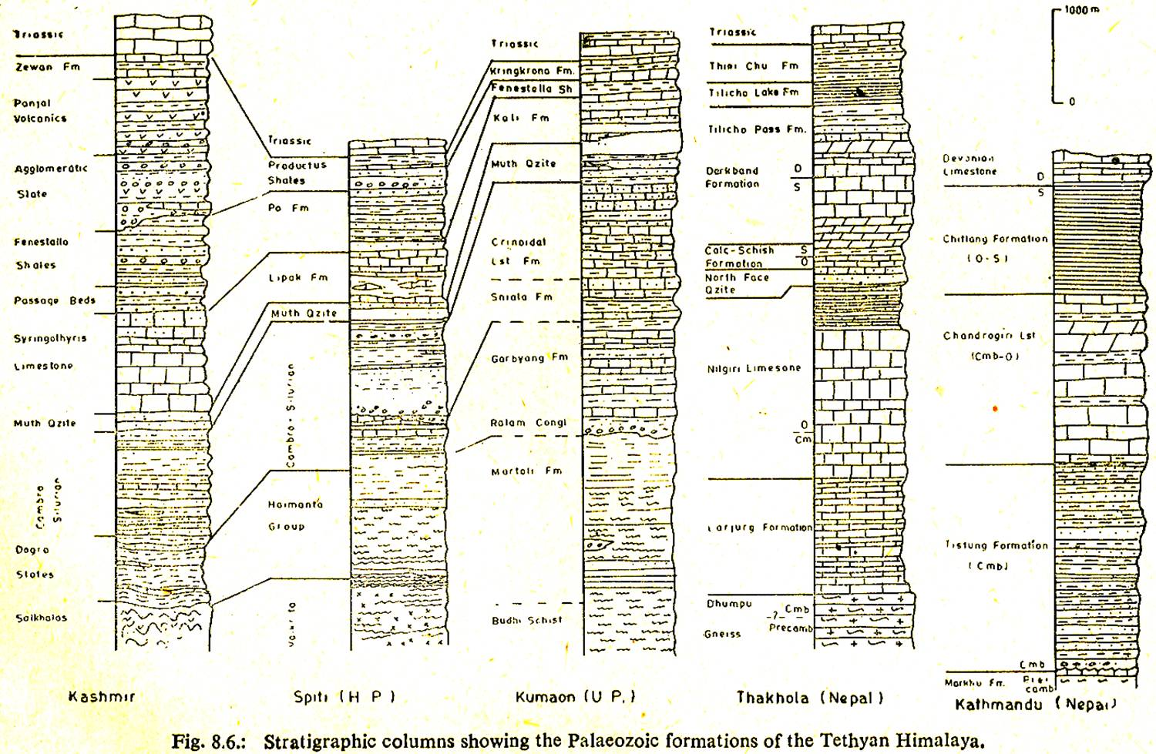

Slide 55
Thank you

